Slide 1
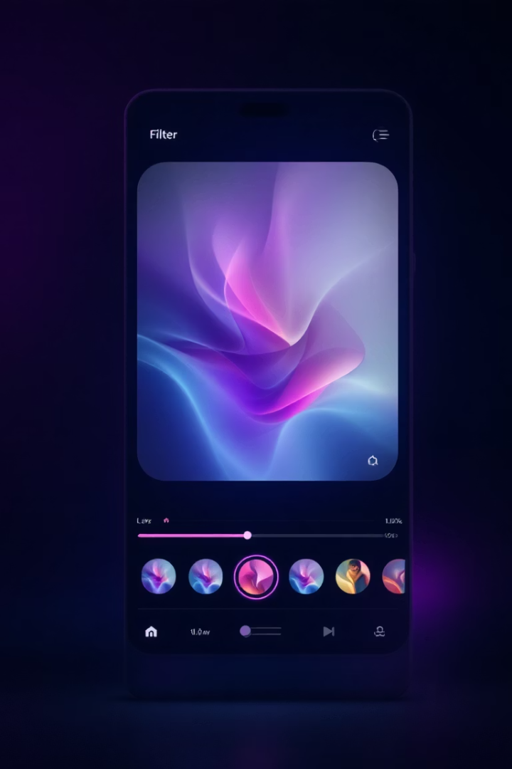

Sleek Image Processing App
A desktop application for real-time image processing developed by Ahsan Khizar & Muhammad Sohaib for Digital Image Processing Lab.

Slide 2
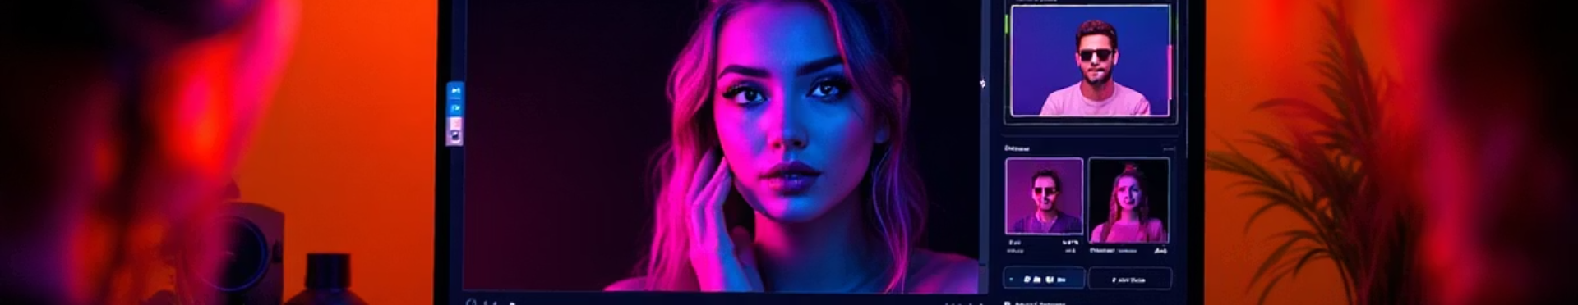
Project Overview
Purpose
Core Idea
Target Users
Develop a modern image processing desktop application using PyQt5 and OpenCV.
Enable real-time image editing with various features.
Students and professionals requiring basic image manipulation tools.

Slide 3
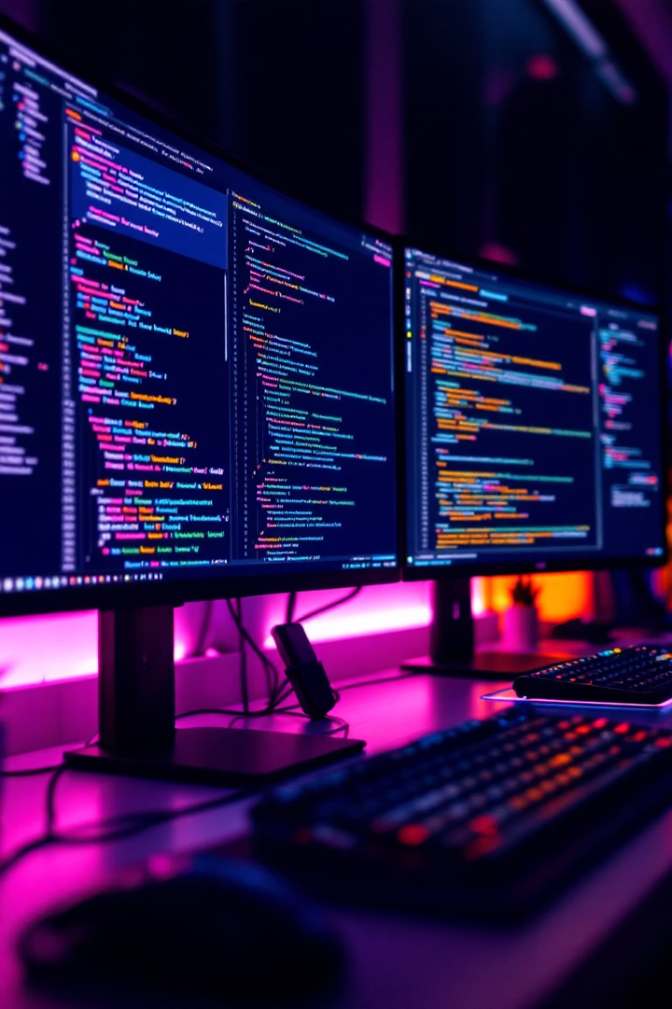




Technologies Used
Python 3
OpenCV
PyQt5
Core programming language with extensive libraries.
Handles all image processing algorithms.
Creates responsive user interface components.
NumPy
Manages complex matrix operations for images.

Slide 4
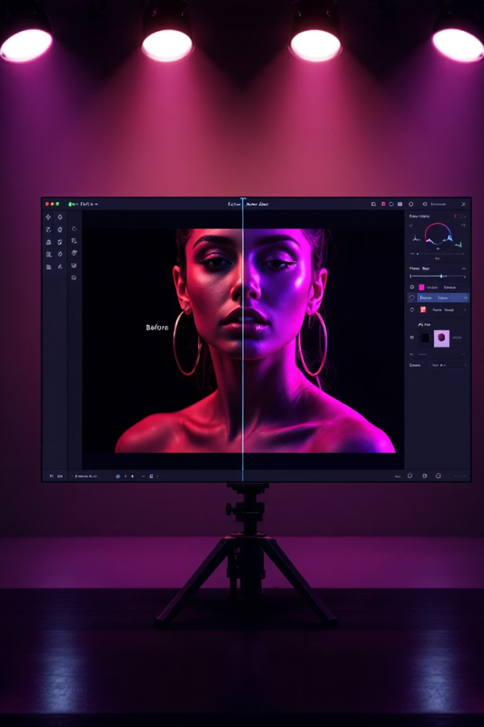




Key Features
File Operations
Load, save, and reset images with drag & drop support.
Image Adjustments
Apply filters and adjust brightness and contrast in real-time.
Camera Integration
Live preview with ability to capture and edit frames.
Drawing Tools
Select colors and brush sizes for image annotation.

Slide 5
User Interface Demo
Main Interface
Drawing Feature
Adjustment Controls
Clean layout with intuitive tool placement. Dark/light themes available.
Freehand drawing with adjustable brush sizes and color picker.
Responsive sliders provide real-time feedback with progress indicators.

Slide 6
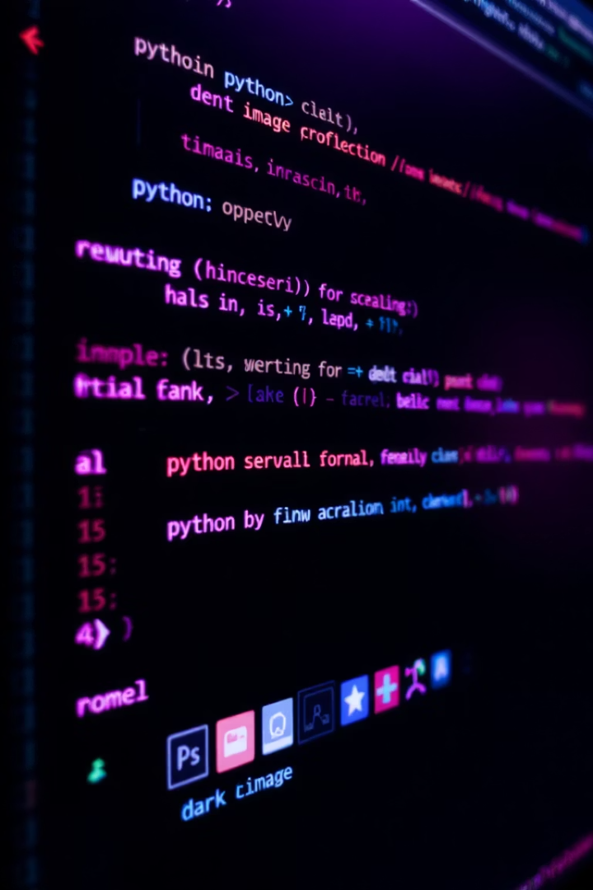




Behind the Scenes
Image Loading & Display
Using OpenCV's imread and PyQt's QPixmap for efficient rendering.
Drawing Logic
Custom event handlers track mouse movement for smooth drawing experience.
Live Camera Integration
Threading implementation ensures UI remains responsive during capture.
Undo Mechanism
Stack-based history system stores image states for reliable navigation.

Slide 7








Results
Performance
Usability
Smooth operation even with high-resolution images.
Intuitive interface requires minimal learning curve.
Requirements
Responsiveness
All project specifications successfully implemented.
UI adapts seamlessly to different window sizes.

Slide 8






Learnings
Problem Solving
Complex UI debugging and optimization techniques.
Technical Integration
Combining OpenCV algorithms with PyQt5 interface components.
GUI Development
Creating responsive, user-friendly application interfaces.

Slide 9
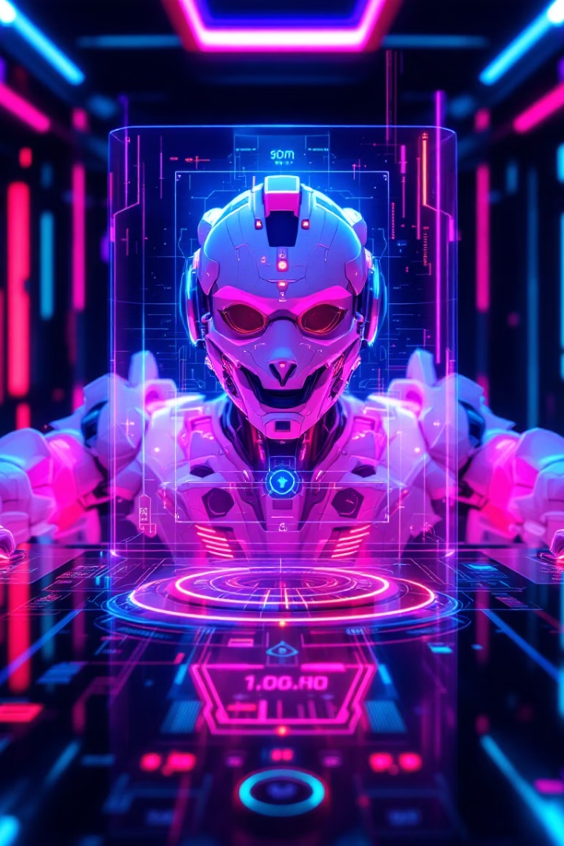
Future Improvements
Advanced Filters
Implement DWT and DCT transforms for sophisticated image processing.
Enhanced Tools
Add cropping, resizing, and multi-format export capabilities.
AI Integration
Develop facial recognition and smart filters using machine learning.

